Slide 1

EMPLOYEE PAYROLL MANAGEMENT
GROUP 2
Bavadharani Raguraj 2486739
Bhavana V 2489016
Bhushan Raghunath Ladhe 2489242
Boreddy Bhavani 2487548
Cheekati Deepak 2489257
Chidurala Shirisha 2489551
Chindam Jhansi 2489042
Dama Naga Jyothi 2488969
Dhairyashil Balaji Patil 2489347

Slide 2

CONTENTS
Objective
Tools & Languages Used
System Requirements
App Flow
E-R Diagram
Features of Employee Payroll Management
Future scope and improvements
Conclusion

Slide 3
OBJECTIVE
The main objective of Employee Payroll Management System is to simplify your burden and to make the process efficiently the technology has given an alternate through software called “Payroll System Software”.
Primarily: Sales, Strategy, Revenue etc.,
Secondarily: Associate with the daily tasks of the business.
This Employee Payroll Management System is used to automate them micro tasks and let the Admin and other departments of a company can on the macro tasks.
To manage the details of Payments, Salary, Working Points, Appraisals, Payroll etc..
Maintaining employee's personal information of Admins, Employees and their payments.
Prepare tax payments for each pay check.
Calculating bonuses and commissions.
Keeping track of Attendance, Time Sheets, Working Hours etc..

Slide 4


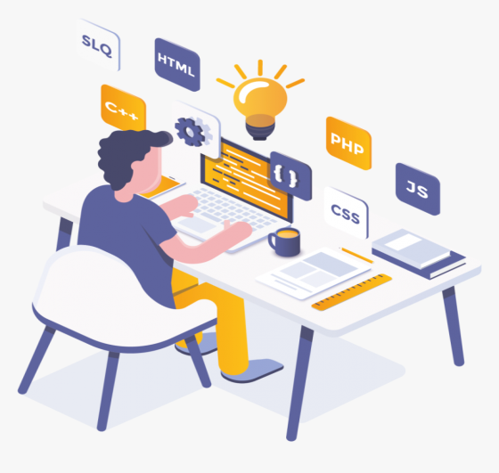
TOOLS AND LANGUAGES USED IN THE PROJECT
FRONT END
Angular
HTML
CSS
BOOTSTRAP
BACK END
Spring Tool Suite
MySQL
Hibernate
Postman

Slide 5





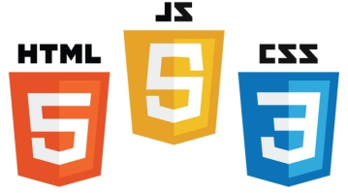
SYSTEM REQUIREMENTS
For creating a dynamic and responsive web application for Employee Payroll Management we need the following requirements..
Software Requirements: Hardware Requirements
OS: Linux, Windows XP and above - minimum of 1gb RAM
Coding Language: JAVA, HTML etc.. - 40gb of Hard Disk
Database: MySQL
Angular, Postman, STS, MySQL, VS code, Eclipse installed.

Slide 6
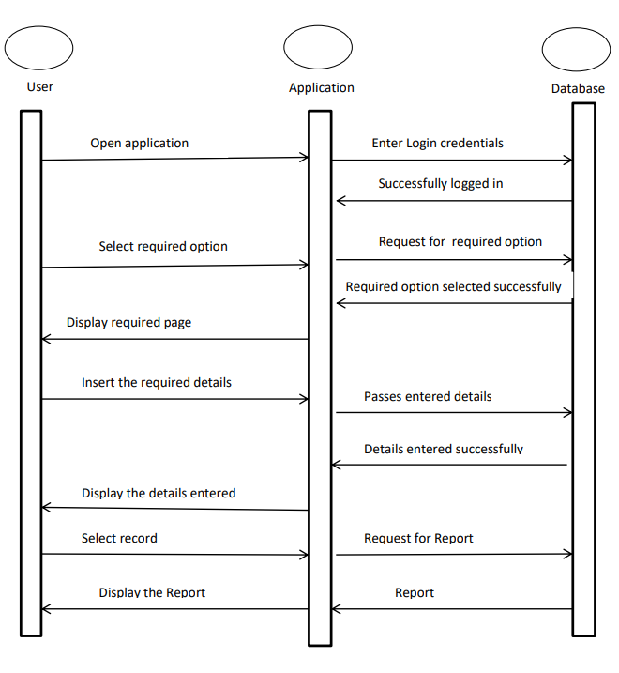
APP Flow

Slide 7
ADMIN
EMAIL ID
PASSWORD
USER NAME
LOCATION
CITY
DOB
PASSWORD
F NAME
EMPLOYEE
PINCODE
L NAME
MOBILE.NO
MAIL ID
STATE
GENDER
DESIGNATION
STREET
HAS
HAS
PF_AMOUNT
BASIC PAY
DATE
DEDUCTION
TIMESHEET
REGULAR TIME
TAX
SALARY
EMP_ID
OVER TIME
NET_PAY
IN TIME
HRA
OUT TIME
TRANS_DATE
TOTAL TIME
GROSS SALARY
BREAK TIME
ER-DIAGRAM

Slide 8
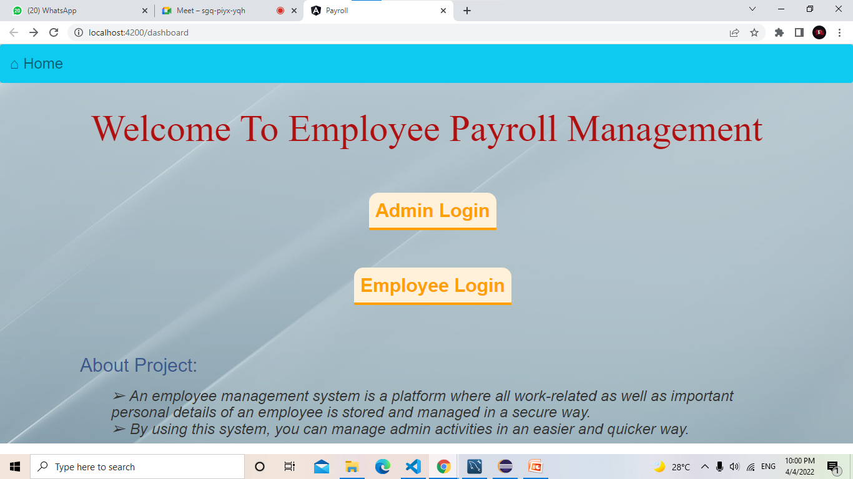
OUTPUT SCREENSHOT: Home Page (dashboard)

Slide 9
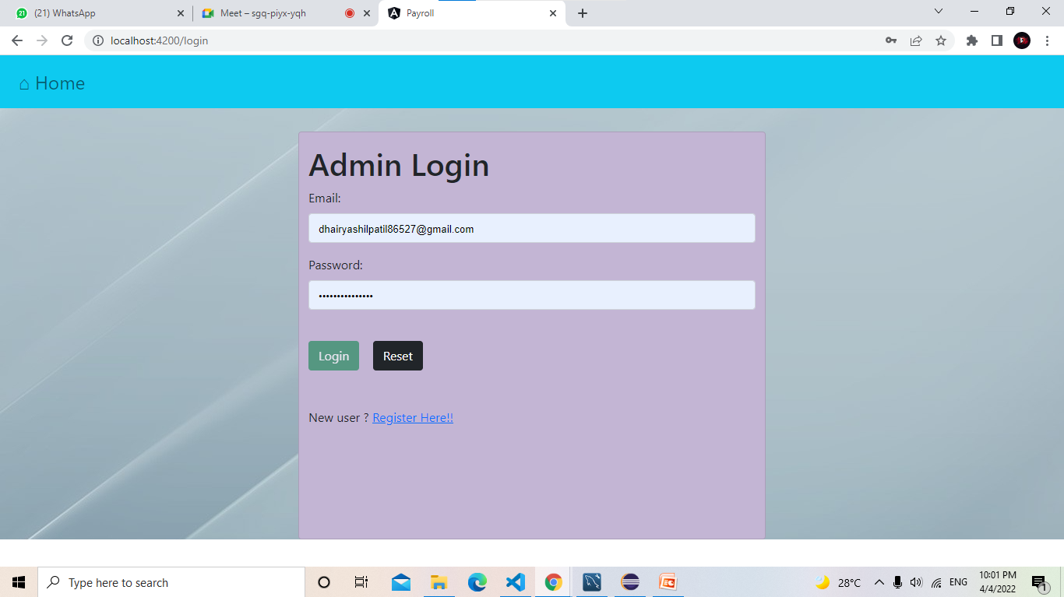
OUTPUT SCREENSHOT: Admin Login

Slide 10
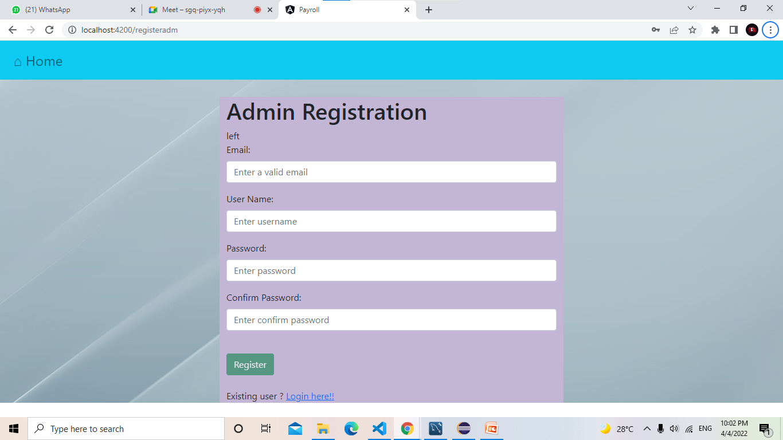
OUTPUT SCREENSHOT: Admin Registration

Slide 11
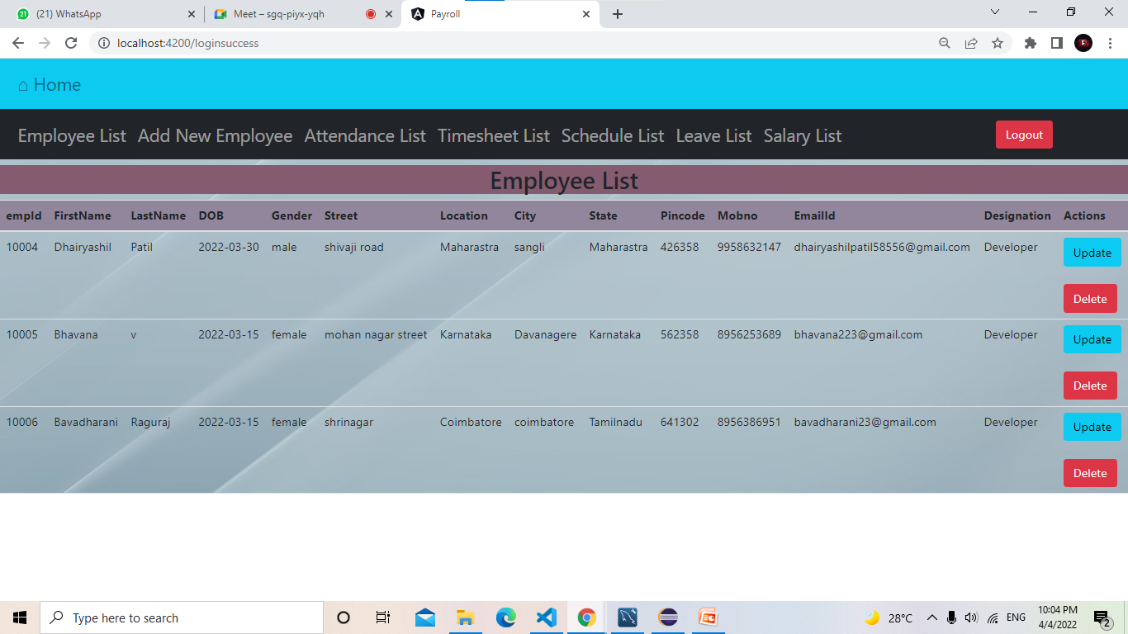
OUTPUT SCREENSHOT: Employee List

Slide 12
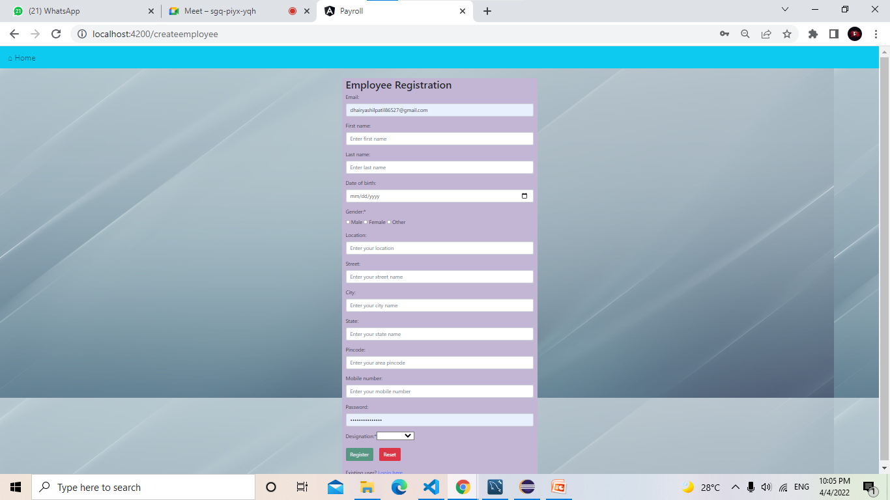
OUTPUT SCREENSHOT: Employee Registration Form

Slide 13
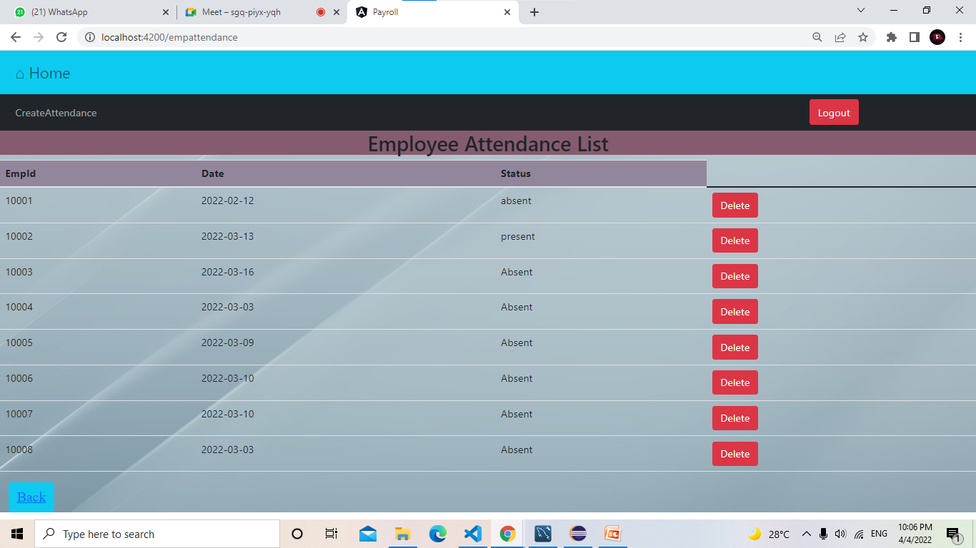
OUTPUT SCREENSHOT: Employee Attendance List

Slide 14
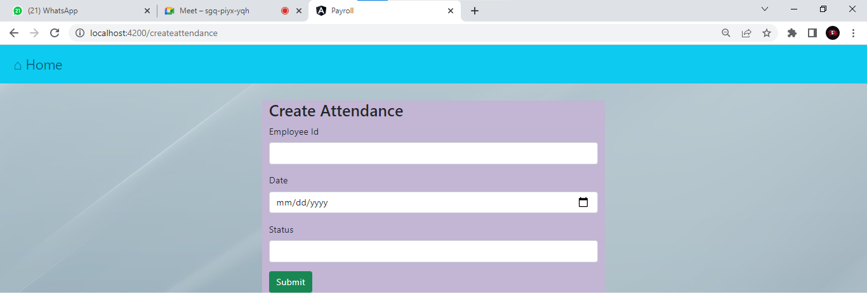
OUTPUT SCREENSHOT: Create Attendance

Slide 15
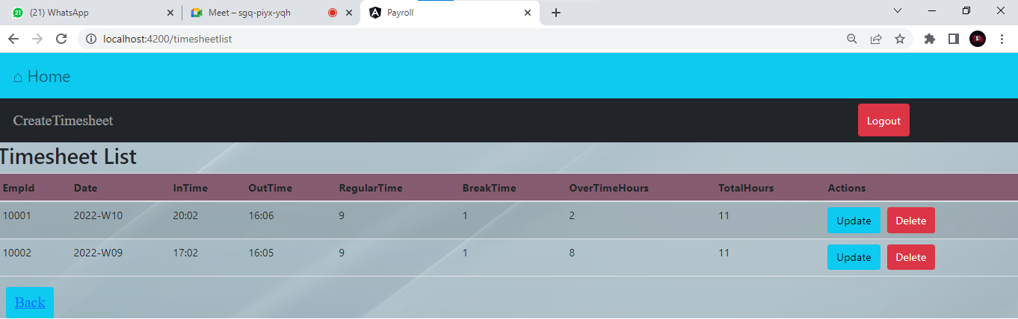
OUTPUT SCREENSHOT: Time Sheet List

Slide 16
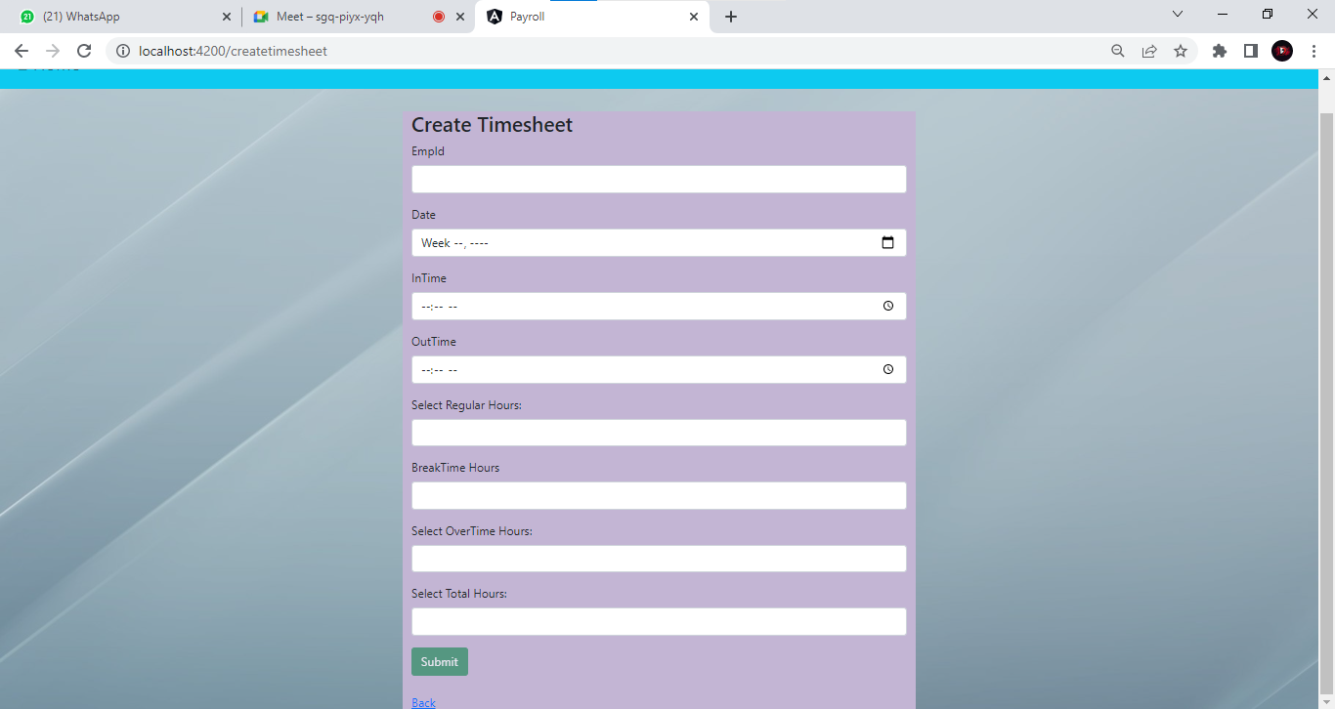
OUTPUT SCREENSHOT: Create Timesheet Form

Slide 17
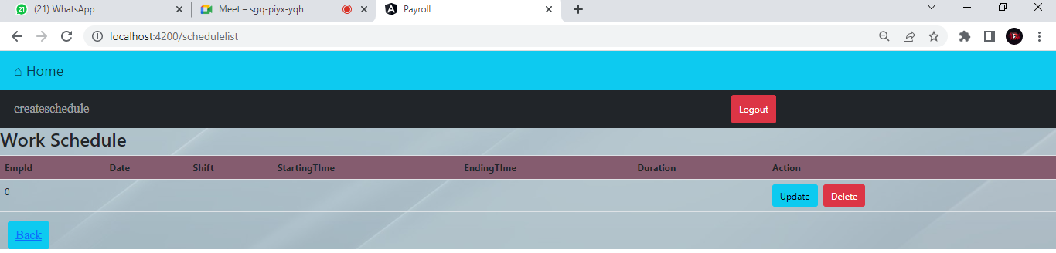
OUTPUT Screenshot: Work Schedule

Slide 18
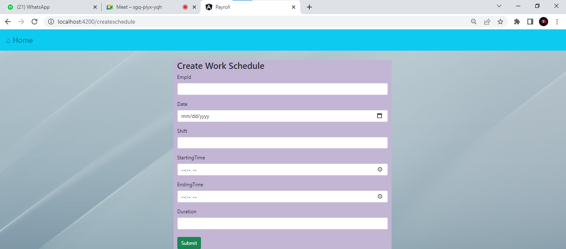
Output: Create Work Schedule Form

Slide 19
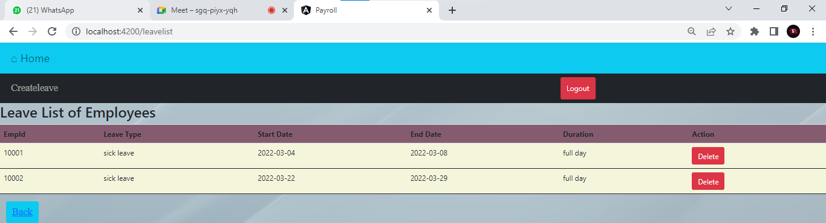
Output: Leave List of Employees

Slide 20
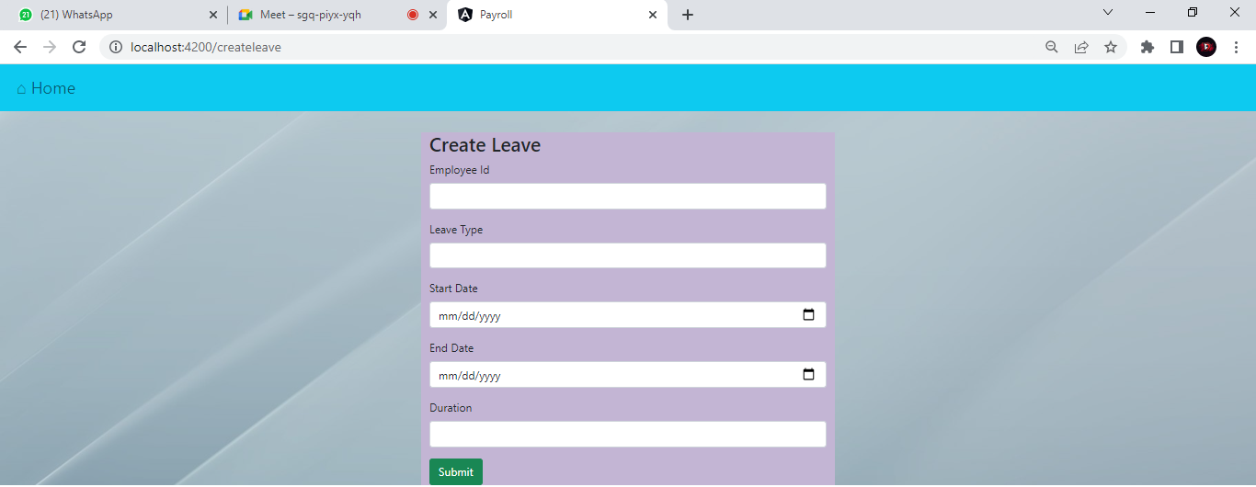
Output: Create Leave Form

Slide 21
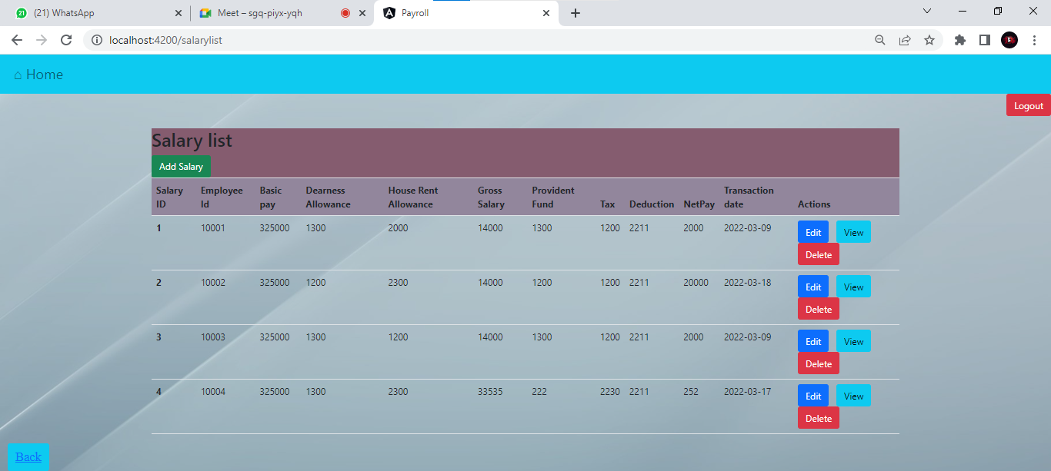
Output: Salary List

Slide 22
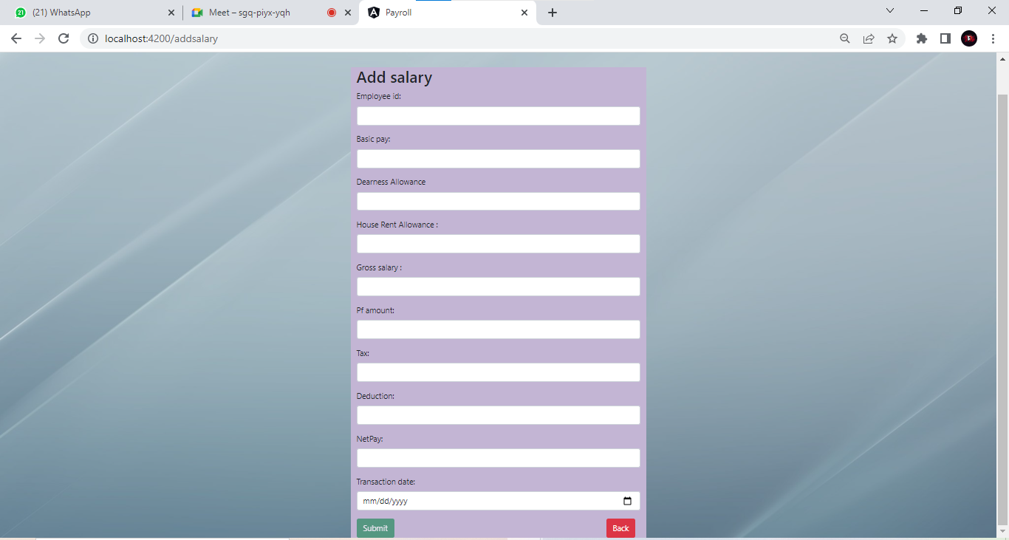
Output: Add Salary Form

Slide 23
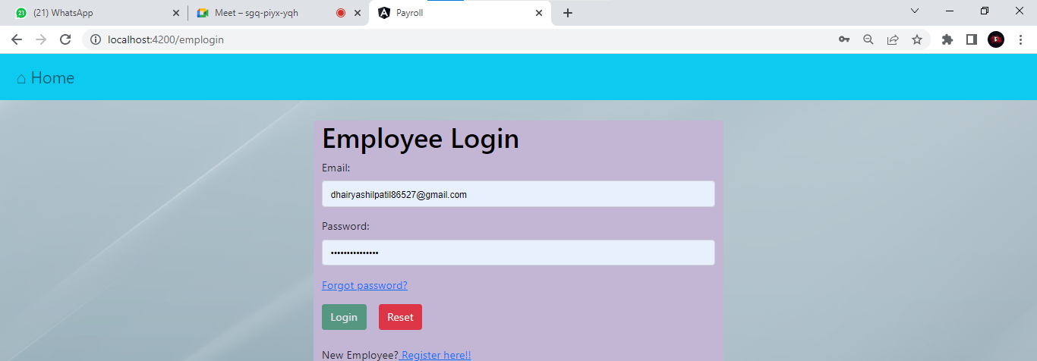
Output: Employee Login

Slide 24
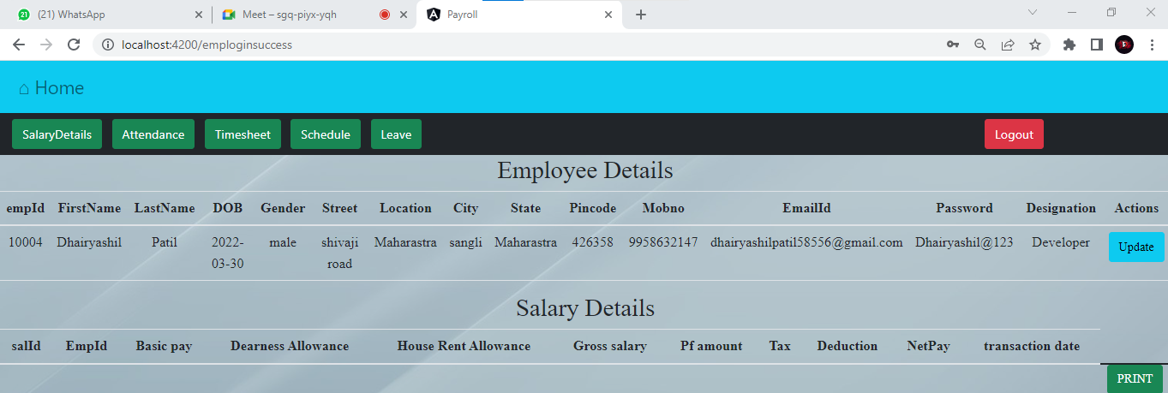
Output: Employee Details & Salary Details

Slide 25
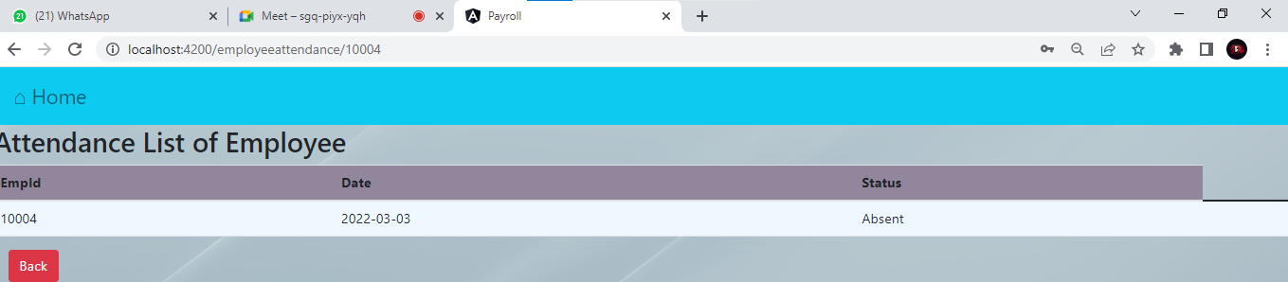
Output: Attendance List of Employee

Slide 26
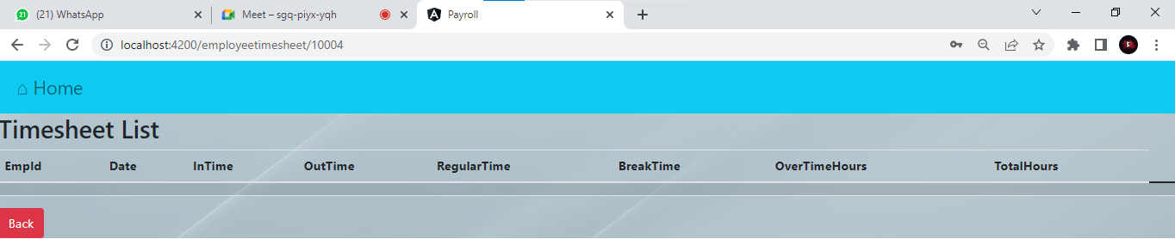
Output: Employee Timesheet

Slide 27
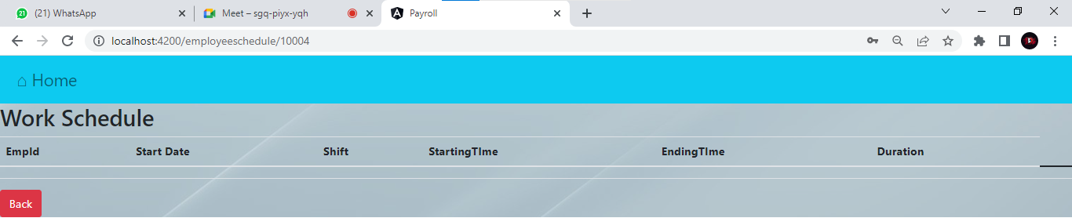
Output: Employee Work Schedule

Slide 28
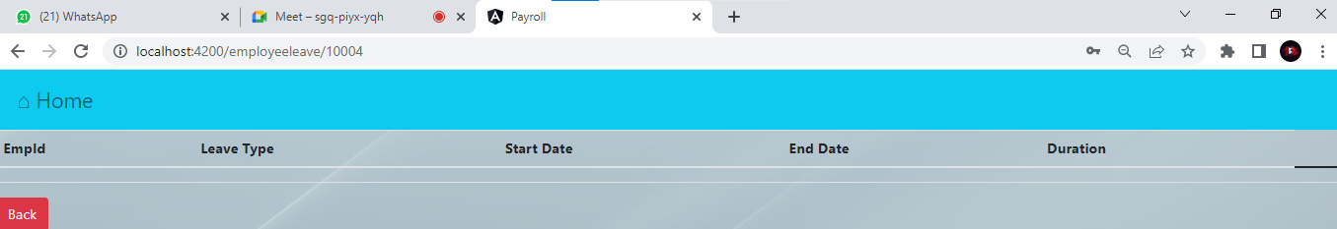
Output: Employee Leave List

Slide 29
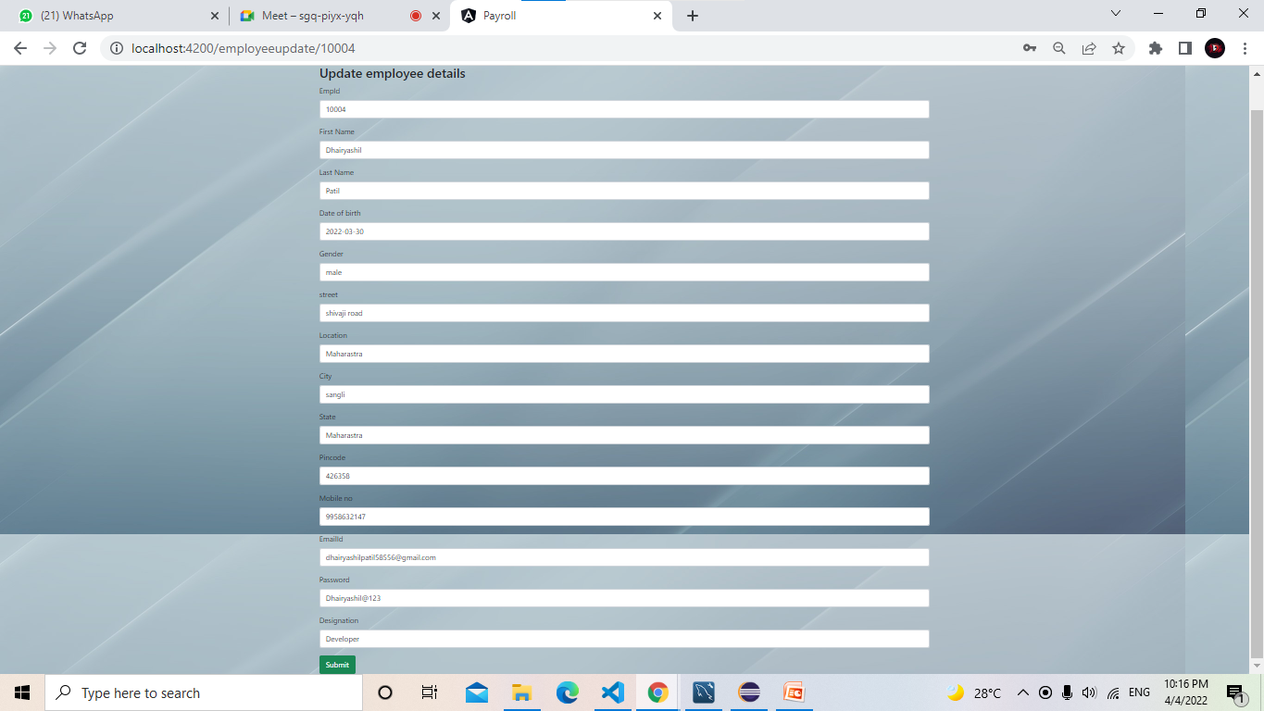
Output: Update Employee List

Slide 30

Features of Employee Payroll Management system
Integrated Accounting.
Calculations are automated so it is highly accurate.
Reporting in Payroll Software.
It is very interactive and saves time.
Tax Management Done Easily.
Reduces paper works.
It is completely controlled by admin.
Customization at its best. ...
High Level of Security.

Slide 31

Future scope and Improvements
The system can be developed in such a way that its existing features can be modified to better versions.
Pay Transparency is Essential.
Efficient payroll systems save time and money
HR Technology Makes Payroll More Efficient.
Cloud-Based Payroll Systems are the Wave of the Future.
This system is very flexible so that the maintenance and further amendments based on the changing environment and requirements can be made easily.
Any changes that may lead to system failures are prevented with security measures.
The project will support a multi-user environment, which is more than one user can access simultaneously.
It can be further developed to include more operations and analysis, as changes are required in the system to adapt to the external developments.

Slide 32

REFERENCES
www.google.com
www.spring.io
www.stackoverflow.com
www.youtube.com
www.w3Schools.com
www.freeCodeCamp.com

Slide 33
Conclusion
Payroll is an important document used by organizations and companies to carry out day-to-day staff Payroll management activities.
It is a document containing a list of all employees of a company who receive remuneration for the work carried out or the services offered to that company.
It provides a detailed pay slip, which can be used for various purposes. It also provides for a detailed breakdown of salary or wages.
It is used to pay salaries or wages.
Also, it is used to collect payroll-related inputs.
Employee ethics.
Manage employee details.
Easy-to-use startup.
Time-saving.
-- THANKYOU EVERYONE --

